Slide 1



JavaScript Syntax
Data Types, Variables, Operators, Expressions, Conditional Statements
Svetlin Nakov
Technical Trainer
www.nakov.com
Software University
http://softuni.bg

Slide 2


Table of Contents
Data Types in JavaScript
Integer, Floating-Point, Boolean, String
Declaring and Using Variables
Operators, Expressions, Statements
Conditional Statements
If-else, switch-case
False-like Conditions
Accessing Forms Fields

Slide 3


Warning: Not for Absolute Beginners
The "JavaScript Basics" course is NOT for absolute beginners
Take the "C# Basics" course at SoftUni first: https://softuni.bg/courses/csharp-basics
The course is for beginners, but requires previous coding skills
Requirements
Coding skills – entry level
Computer English – entry level
Logical thinking
coding skills
required!

Slide 4


Data Types in JavaScript

Slide 5

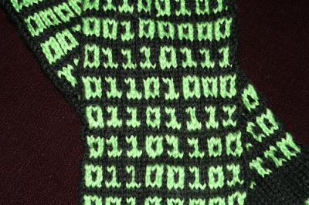
What Is a Data Type?
A data type:
Is a domain of values of similar characteristics
Defines the type of information stored in the computer memory (in a variable)
Examples:
Positive integers: 1, 2, 3, …
Alphabetical characters: a, b, c, …
Dates from the calendar: 1-Nov-2014, 3-Sep-2006, …

Slide 6
JavaScript Data Types
JavaScript is a typeless language
The variable types are not explicitly defined
The type of a variable can be changed at runtime
Variables in JS are declared with the keyword var
var count = 5; // variable holds an integer value
count = 'hello'; // the same variable now holds a string
var name = 'Svetlin Nakov'; // variable holds a string
var mark = 5.25 // mark holds a floating-point number

Slide 7
Integer Numbers
Integer types represent whole numbers
In JavaScript integer numbers are in the range from -9007199254740992 to 9007199254740992
The underlying type is a 64-bit floating-point number (IEEE-754)
var maxInteger = 9007199254740992;
var minInteger = -9007199254740992;
var a = 5, b = 3;
var sum = a + b; // 8
var div = a / 0; // Infinity

Slide 8
Floating-Point Numbers
Floating-point types represent real numbers, e.g. 3.75
In JavaScript the floating-point numbers are 64-bit
Stored in the IEEE-754 format
Have range from -1.79e+308 to 1.79e+308
Have precision of 15-16 digits
The smallest positive number is 5.0e-324
Can behave abnormally in the calculations
E.g. 0.1 + 0.2 = 0.30000000000000004

Slide 9
Floating-Point Numbers – Example
var PI = Math.PI; // 3.141592653589793
var minValue = Number.MIN_VALUE; // 5e-324
var maxValue = Number.MAX_VALUE; // 1.79e+308
var div0 = PI / 0; // Infinity
var divMinus0 = -PI / 0; // -Infinity
var unknown = div0 / divMinus0; // NaN
var a = 0.1;
var b = 0.2;
var sum = 0.3;
var equal = (a+b == sum); // false!!!
console.log('a+b = '+ (a+b) + ', sum = ' + sum + ',
sum == a+b? is ' + equal);

Slide 10
Numbers in JavaScript
All numbers in JavaScript are stored internally as double-precision floating-point numbers (64-bit)
According to the IEEE-754 standard
Can be wrapped as objects of type Number
var value = 5;
value = 3.14159;
value = new Number(100); // Number { 100 }
value = value + 1; // 101
var biggestNum = Number.MAX_VALUE;

Slide 11
Numbers Conversion
Convert floating-point to integer number
Convert to integer number with rounding
Convert string to integer
var valueDouble = 8.75;
var valueInt = Math.floor(valueDouble); // 8
var valueDouble = 8.75;
var valueInt = Math.round(valueDouble); // 8
var str = '1234';
var i = Number(str) + 1; // 1235

Slide 12
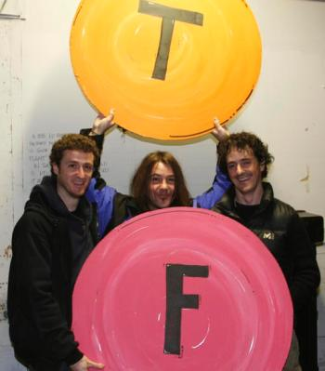
The Boolean Data Type
The Boolean data type:
Has two possible values: true and false
Is useful in logical expressions
Example of Boolean variables:
var a = 1;
var b = 2;
var greaterAB = (a > b);
console.log(greaterAB); // false
var equalA1 = (a == 1);
console.log(equalA1); // true

Slide 13
The String Data Type
The string data type represents a sequence of characters
Strings are enclosed in quotes:
Both ' and " work correctly
Best practices suggest using single quotes
Strings can be concatenated (joined together)
Using the + operator
var s = 'Welcome to JavaScript';
var name = 'Soft' + ' ' + 'Uni';

Slide 14
Strings are Unicode
Strings are stored internally in Unicode
Unicode supports all commonly used alphabets in the world
E.g. Cyrillic, Chinese, Arabic, Greek, etc. scripts
var asSalamuAlaykum = 'السلام عليكم';
alert(asSalamuAlaykum);
var кирилица = 'Това е на кирилица!';
alert(кирилица);
var leafJapanese = '葉'; // Pronounced as "ha"
alert(leafJapanese);

Slide 15
Object Type
Objects in JavaScript hold key-value pairs:
var obj = { name : "SoftUni", age : 2 };
console.log(obj); // Object {name: "SoftUni", age: 2}
obj['site'] = "http://www.softuni.bg";
obj.age = 10;
obj['name'] = "Software University";
console.log(obj); // Object {name: "Software University", age: 10, site: "http://www.softuni.bg"}
delete obj.name;
delete obj.site;
console.log(obj); // Object {age: 10}

Slide 16

Data Types in JavaScript
Live Demo

Slide 17



Undefined and Null Values
What is 'undefined' in JavaScript?

Slide 18
Undefined and Null Values
In JS there is a special value undefined
It means the variable has not been defined (no such variable exist in the current context)
Undefined is different than null
Null means that an object exists and is empty (has no value)
var x = 5;
x = undefined;
alert(x); // undefined
x = null;
alert(x); // null

Slide 19
Checking the Type of a Variable
The variable type can be checked at runtime:
var x = 5;
console.log(typeof(x)); // number
console.log(x); // 5
x = new Number(5);
console.log(typeof(x)); // object
console.log(x); // Number {}
x = null;
console.log(typeof(x)); // object
x = undefined;
console.log(typeof(x)); // undefined

Slide 20

Undefined / Null / Typeof
Live Demo

Slide 21

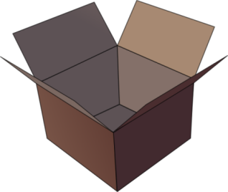
Declaring and Using Variables
p
q
i

Slide 22
What Is a Variable?
A variable is a:
Placeholder of information that can be changed at run-time
A piece of computer memory holding some value
Variables allow you to:
Store information
Retrieve the stored information
Change the stored information
p
q
i

Slide 23

Variable Characteristics
A variable has:
Name
Type (of stored data)
Value
Example:
Name: counter
Type: number
Value: 5
var counter = 5;

Slide 24
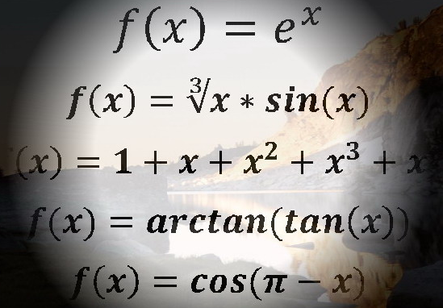
Declaring Variables
When declaring a variable we:
Specify its name (called identifier)
The type is inferred by the value
Give it an initial value
Example:
var
var height = 200;
var str = "Hello";
var obj = { name : 'Peter', age : 19 };

Slide 25
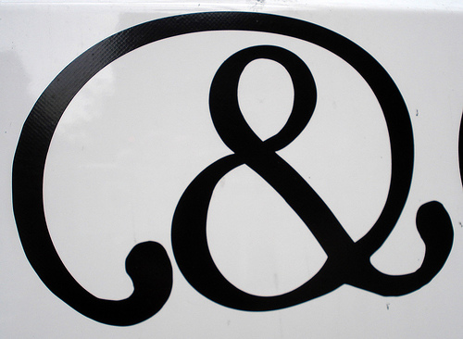
Identifiers
Identifiers may consist of:
Letters (Unicode), digits [0-9], underscore '_', dollar '$'
Cannot start with a digit
Cannot be a JavaScript keyword
Identifiers in JavaScript are case-sensitive
Identifiers should have a descriptive name
Only Latin letters
Variables and functions names: use camelCase

Slide 26
Identifiers – Examples
Examples of correct identifiers:
Examples of incorrect identifiers:
var New = 2; // Here N is capital, so it's not a JS keyword
var _2Pac = 2; // This identifier begins with _
var поздрав = 'Hello'; // Unicode symbols used
// The following is more appropriate:
var greeting = 'Hello';
var n = 100; // Undescriptive
var numberOfClients = 100; // Descriptive
// Overdescriptive identifier:
var numberOfPrivateClientOfTheFirm = 100;
var new = 5; // new is a keyword
var 2Pac = 2; // Cannot begin with a digit

Slide 27
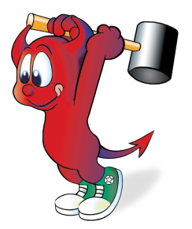
Assigning Values
The = operator is used to assign a value to a variable:
// Assign a value to a variable
var firstValue = 5;
// Using an already declared variable:
var secondValue = firstValue;
// The following cascade calling assigns 3 to firstValue
// and then firstValue to thirdValue, so both variables
// have the value 3 as a result:
var thirdValue = firstValue = 3; // Avoid this!

Slide 28
Local and Global Variables
Local variables
Declared with the keyword var
Global variables
Declared without the keyword var
Stored as properties of the window object
Using global variables is very bad practice!
var a = 5; // a is local in the current scope
a = 'alabala'; // the same a is referenced here
a = 5; // the same as window.a = 5;

Slide 29
Variables in JavaScript
A variable in JavaScript can be:
unresolvable
undefined
null
local
global
Read more here: http://javascriptweblog.wordpress.com/2010/08/16/understanding-undefined-and-preventing-referenceerrors/
console.log(asfd); // ReferenceError
var p = undefined; console.log(p); // undefined
var p = null; console.log(p); // null
var localVar = 5; console.log(localVar); // 5
globalVar = 5; console.log(globalVar); // 5

Slide 30
Unresolvable Variables and Undefined
Unresolvable variables in JavaScript are different than undefined
console.log(msg); // ReferenceError: msg is not defined
var greeting = 'hello'; // A local variable
console.log(greeting); // hello
msg = greeting; // msg is a global variable with value 'hello'
console.log(msg); // hello
msg = undefined; // Different than "delete msg"
console.log(msg); // undefined
console.log(greeting); // hello
delete msg; // Delete a global variable
console.log(msg); // ReferenceError: msg is not defined

Slide 31
Unresolvable Variables – Examples
In this code secondVar is unresolvable:
In this code second is undefined (instead of unresolvable):
var firstVar = 10;
console.log(firstVar); // 10
console.log(secondVar); // ReferenceError: secondVar is not defined
console.log(first); // undefined
var first = 20;
console.log(first); // 20

Slide 32
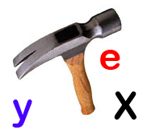

Unresolvable Variables
Live Demo

Slide 33
JavaScript Strict Syntax
It is recommended to enable the "strict syntax"
Converts global variables usage to runtime errors
"use strict";
var local = 5; // Local variables will work in strict mode
global = 10; // Uncaught ReferenceError: x is not defined
// This code will not be executed, because of the error above
console.log(5 * 5);

Slide 34
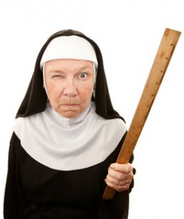
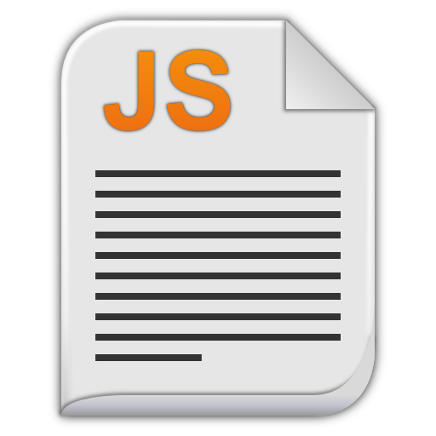

JavaScript Strict Syntax
Live Demo

Slide 35

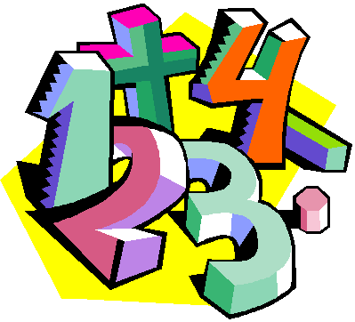
Operators in JavaScript
Arithmetic, Logical, Comparison, Assignment, …

Slide 36
What is an Operator?
Operator is an operation performed over data at runtime
Takes one or more arguments (operands)
Produces a new value
Operators have precedence
Precedence defines which will be evaluated first
Operators are used to build expressions
Expressions are sequences of operators and operands that are evaluated to a single value

Slide 37
Categories of Operators in JS
Category | Operators
Arithmetic | + - * / % ++ --
Logical | && || ^ !
Binary | & | ^ ~ << >>
Comparison | == != < > <= >= === !==
Assignment | = += -= *= /= %= &= |= ^= <<= >>=
String concatenation | +
Other | . [] () ?: new

Slide 38
Operators Precedence
Precedence | Operators
Highest | ()
 | ++ -- (postfix) new typeof
 | ++ -- (prefix) + - (unary) ! ~
 | * / %
 | + -
 | << >>
 | < > <= >= is as
 | == !=
Lower | &

Slide 39
Operators Precedence (2)
Precedence | Operators
Higher | ^
 | |
 | &&
 | ||
 | ?:
Lowest | = *= /= %= += -= <<= >>= &= ^= |=
Parenthesis operator always has the highest precedence
Note: prefer using parentheses, even when it seems stupid to do so

Slide 40
Arithmetic Operators
Arithmetic operators +, -, *, / are the same as in math
The division operator / returns number or Infinity or NaN
Remainder operator % returns the remainder from division of numbers
Even on real (floating-point) numbers
E.g. 5.3 % 3 → 2.3
The operator ++ / -- increments / decrement a variable
Prefix ++ vs. postfix ++

Slide 41
Logical Operators
Logical operators take boolean operands and return boolean result
Operator ! turns true to false and false to true
Behavior of the operators &&, || and ^ (1 == true, 0 == false):
Operation | || | || | || | || | && | && | && | && | ^ | ^ | ^ | ^
Operand1 | 0 | 0 | 1 | 1 | 0 | 0 | 1 | 1 | 0 | 0 | 1 | 1
Operand2 | 0 | 1 | 0 | 1 | 0 | 1 | 0 | 1 | 0 | 1 | 0 | 1
Result | 0 | 1 | 1 | 1 | 0 | 0 | 0 | 1 | 0 | 1 | 1 | 0

Slide 42
Bitwise Operators
Bitwise operators in JS always work for 32-bit integers
Bitwise operator ~ turns all 0 to 1 and all 1 to 0
Like ! for boolean expressions but works bit by bit
The operators |, & and ^ behave like bitwise ||, && and ^
The << and >> move the bits (left or right)
Behavior of the operators |, & and ^:
Operation | | | | | | | | | & | & | & | & | ^ | ^ | ^ | ^
Operand1 | 0 | 0 | 1 | 1 | 0 | 0 | 1 | 1 | 0 | 0 | 1 | 1
Operand2 | 0 | 1 | 0 | 1 | 0 | 1 | 0 | 1 | 0 | 1 | 0 | 1
Result | 0 | 1 | 1 | 1 | 0 | 0 | 0 | 1 | 0 | 1 | 1 | 0

Slide 43
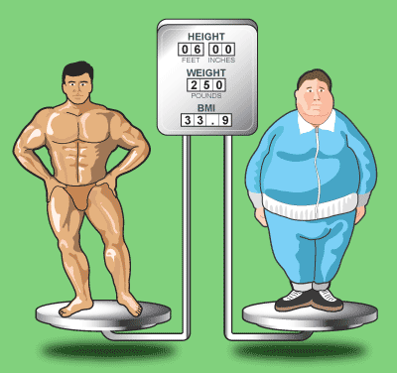
Comparison Operators
Comparison operators are used to compare variables
==, <, >, >=, <=, !=, ===, !==
The == means "equal after type conversion"
The === means "equal and of the same type"
var a = 5;
var b = 4;
console.log(a >= b); // True
console.log(a != b); // True
console.log(a == b); // False
console.log(0 == ""); // True
console.log(0 === ""); // False

Slide 44
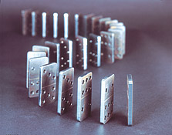
Assignment Operators
Assignment operators are used to assign a value to a variable
=, +=, -=, |=, ...
Assignment operators example:
var x = 6;
var y = 4;
console.log(y *= 2); // 8
var z = y = 3; // y=3 and z=3
console.log(z); // 3
console.log(x |= 1); // 7
console.log(x += 3); // 10
console.log(x /= 2); // 5

Slide 45

Operators in JavaScript
Live Demo

Slide 46
Other Operators
String concatenation operator + is used to concatenate strings
If the second operand is not a string, it is converted to string automatically
Member access operator . is used to access object members
Square brackets [] are used with arrays to access element by index
Parentheses () are used to override the default operator precedence
var output = "The number is : ";
var number = 5;
console.log(output + number);
// The number is : 5

Slide 47
Other Operators (3)
Conditional operator ?: has the form
(if b is true then the result is x else the result is y)
The new operator is used to create new objects
The typeof operator returns the type of the object
this operator references the current context
In JavaScript the value this depends on the current scope
b ? x : y

Slide 48
Other Operators (3)
var obj = {};
obj.name = "SoftUni";
obj.age = 2;
console.log(obj); // Object {name: "SoftUni", age: 2}
var a = 6;
var b = 4;
console.log(a > b ? "a > b" : "b >= a"); // a>b
var c = b = 3; // b=3; followed by c=3;
console.log(c); // 3
console.log((a+b)/2); // 4.5
console.log(typeof(a)); // number
console.log(typeof([])); // object

Slide 49

Other Operators
Live Demo

Slide 50
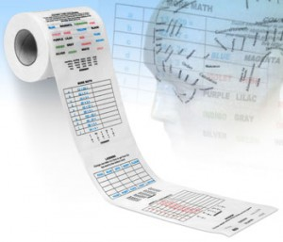
Expressions

Slide 51
Expressions
Expressions are
Sequences of operators, literals and variables that are evaluated to some value
Examples:
var r = (150-20) / 2 + 5; // r=70
// Expression for calculation of circle area
var surface = Math.PI * r * r;
// Expression for calculation of circle perimeter
var perimeter = 2 * Math.PI * r;

Slide 52
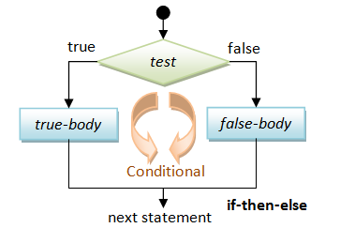
if and if-else
Implementing Conditional Logic

Slide 53
Conditional Statements: if-else
JavaScript implements the classical if / if-else statements:
var number = 5;
if (number % 2 == 0) {
console.log("This number is even.");
}
else {
console.log("This number is odd.");
}

Slide 54

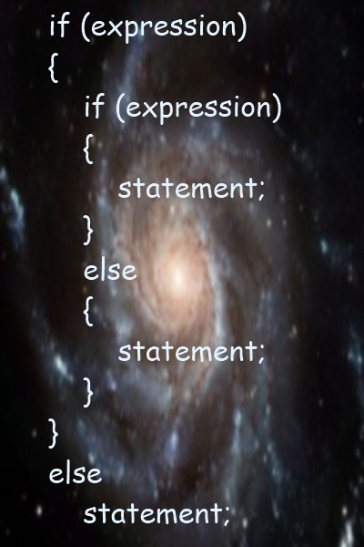
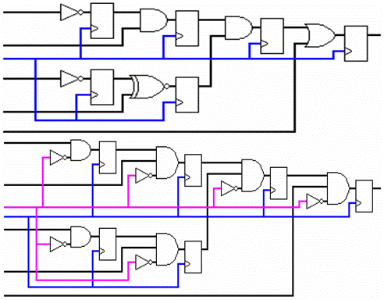
if and if-else
Live Demo

Slide 55

switch-case
Making Several Comparisons at Once

Slide 56
The switch-case Statement
Selects for execution a statement from a list depending on the value of the switch expression
switch (day) {
case 1: console.log('Monday'); break;
case 2: console.log('Tuesday'); break;
case 3: console.log('Wednesday'); break;
case 4: console.log('Thursday'); break;
case 5: console.log('Friday'); break;
case 6: console.log('Saturday'); break;
case 7: console.log('Sunday'); break;
default: console.log('Error!'); break;
}

Slide 57
How switch-case Works?
The expression is evaluated
When one of the constants specified in a case label is equal to the expression
The statement that corresponds to that case is executed
If no case is equal to the expression
If there is default case, it is executed
Otherwise the control is transferred to the end point of the switch statement
The break statement exits the switch-case statement

Slide 58

The switch-case Statement
Live Demo

Slide 59

False-like Conditions
Strange Behavior

Slide 60
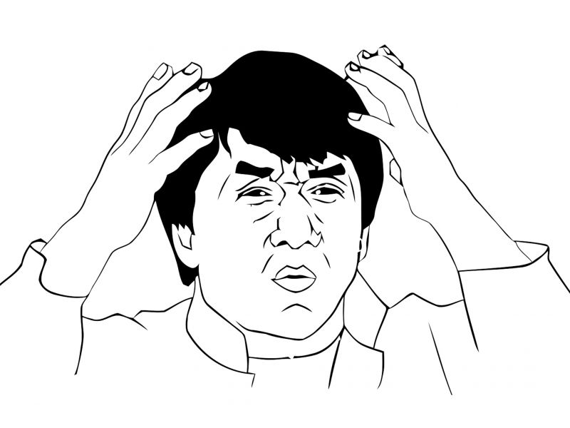
False-like Conditions
Values converted to false
0 == false (zero)
"0" == false (zero as string)
"" == false (empty string)
[] == false (empty array)
Values converted to true
1 == true (one)
"1" == true (one as string)
!0 == true (the opposite of 0)

Slide 61

Absurd Behavior in JavaScript
JavaScript is rich of absurd / unexpected / strange behavior
Learn more at WTF JS: http://wtfjs.com
"0" == false // true
if ("0") console.log(true); // true
[] == false // true
if ([]) console.log(true); // true
null == false // false
!null // true

Slide 62

False-like Conditions
Live Demo

Slide 63

Accessing Form Fields
Reading and Writing Form Data

Slide 64
Accessing Forms Fields
You can access the form fields by their ID:
<input type="text" id="textField" />
<div id="result" />
<script>
var text = document.getElementById("textField").value;
var resultWrapper = document.getElementById('result');
resultWrapper.innerHTML = "some text";
</script>

Slide 65
Accessing Form Fields
Live Demo

Slide 66


Summary
JavaScript dynamic data types
Number, String, Boolean, Undefined, Null
Local and Global variables
Operators (same as in C#, Java and C++)
Expressions (same as in C#, Java and C++)
If-else statements (same as in C#, Java and C++)
Switch-case statement (similar to Java / C#)
False-like Conditions
Accessing Form Fields
JS Basics

Slide 67
JavaScript Syntax
https://softuni.bg/courses/javascript-basics/

Slide 68
License
This course (slides, examples, demos, videos, homework, etc.) is licensed under the "Creative Commons Attribution-NonCommercial-ShareAlike 4.0 International" license
Attribution: this work may contain portions from
“JavaScript Basics" course by Telerik Academy under CC-BY-NC-SA license

Slide 69





Free Trainings @ Software University
Software University Foundation – softuni.org
Software University – High-Quality Education, Profession and Job for Software Developers
softuni.bg
Software University @ Facebook
facebook.com/SoftwareUniversity
Software University @ YouTube
youtube.com/SoftwareUniversity
Software University Forums – forum.softuni.bg

